Slide 1

Chapter 11
File Systems and Directories

Slide 2
Chapter Goals (1 of 2)
Describe the purpose of files, file systems, and directories
Distinguish between text and binary files
Identify various file types by their extensions
Explain how file types improve file usage
Define the basic operations on a file

Slide 3
Chapter Goals (2 of 2)
Compare and contrast sequential and direct file access
Discuss the issues related to file protection
Describe a directory tree
Create absolute and relative paths for a directory tree
Describe several disk-scheduling algorithms

Slide 4
File Systems
File
A named collection of related data, used for organizing secondary memory
File System
The operating system's logical view of the files it manages
Directory
A named group of files

Slide 5
Text and Binary Files (1 of 2)
Text File
A file that contains characters from the ASCII or Unicode character sets
Binary File
A file that contains data in a specific format, requiring special interpretation of its bits

Slide 6
Text and Binary Files (2 of 2)
The terms text file and binary file are somewhat misleading
Ultimately, all information on a computer is stored as binary digits
Text files are formatted as chunks of 8 or 16 bits, interpreted as characters
Binary files are formatted in some other special format

Slide 7
File Types (1 of 2)
File Type
The kind of information contained in a document
Most files, regardless of format, contain a specific type of information
File Extension
Part of a file name that indicates the type
File names are often in two parts:
File name . File Extension

Slide 8
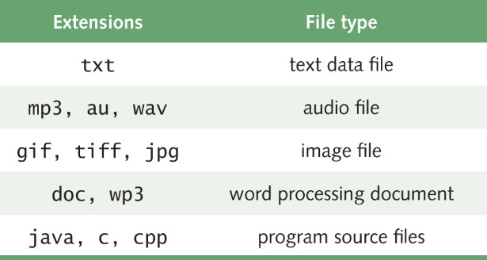
File Types (2 of 2)
What kinds of files are the following?
Chapter.doc
Figure1.jpg
Interview.wav
MyFavorite.mp3
Some common file types and their extensions
What's the advantage of using the
appropriate extension?

Slide 9
File Operations
What operations do you think you might want to perform on or with a file?

Slide 10
File Access
Sequential Access
The technique in which data in a file are accessed in a linear fashion; to get the last record, you must read all of the records
Direct Access
The technique in which data in a file are conceptually divided into numbered logical records and accessed directly, by specifying logical record numbers

Slide 11
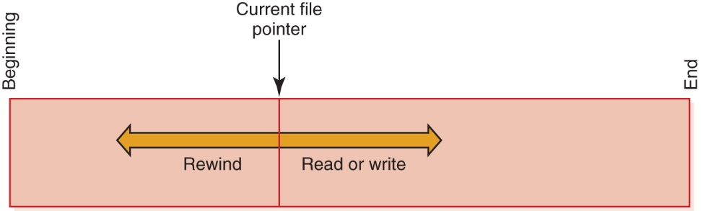
Sequential File Access
Sequential file access

Slide 12
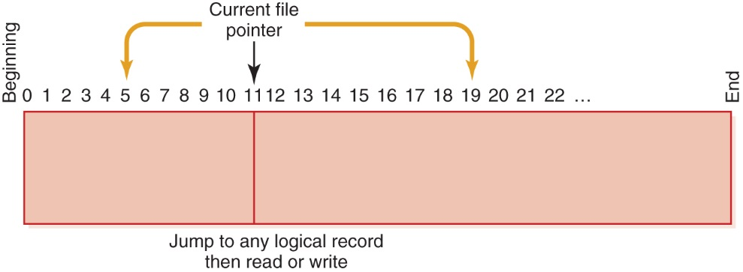
Direct File Access
Direct file access

Slide 13
File Access
Which file access do you think is easier to implement: sequential access or direct access?

Slide 14
File Protection
File protection
The process of limiting file access
In multiuser systems, file protection is of primary importance
We don’t want one user to be able to access another user’s files unless the access is specifically allowed
A file protection mechanism determines who can use a file and for what general purpose
Why is file protection important?
Give two examples

Slide 15
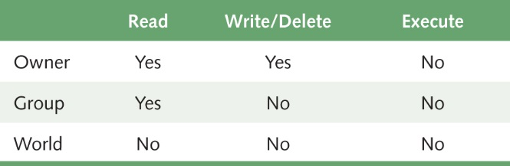
File Protection
An example of a file protection scheme is the file settings in the UNIX operating system, which are divided into three categories

Slide 16
Directory Trees (1 of 4)
Recall that a directory is a named group of files
A directory can be contained within another directory
Directory
Edition 3
CSI PP Slides
Directory
…
Chapter01.ppt
Chapter17.ppt
Files

Slide 17
Directory Trees (2 of 4)
Parent Directory
The containing directory
Subdirectory
The directory being contained
Directory Tree
A logical view of a file system; a structure showing the nested directory organization of a file system
Root Directory
The directory at the highest level

Slide 18
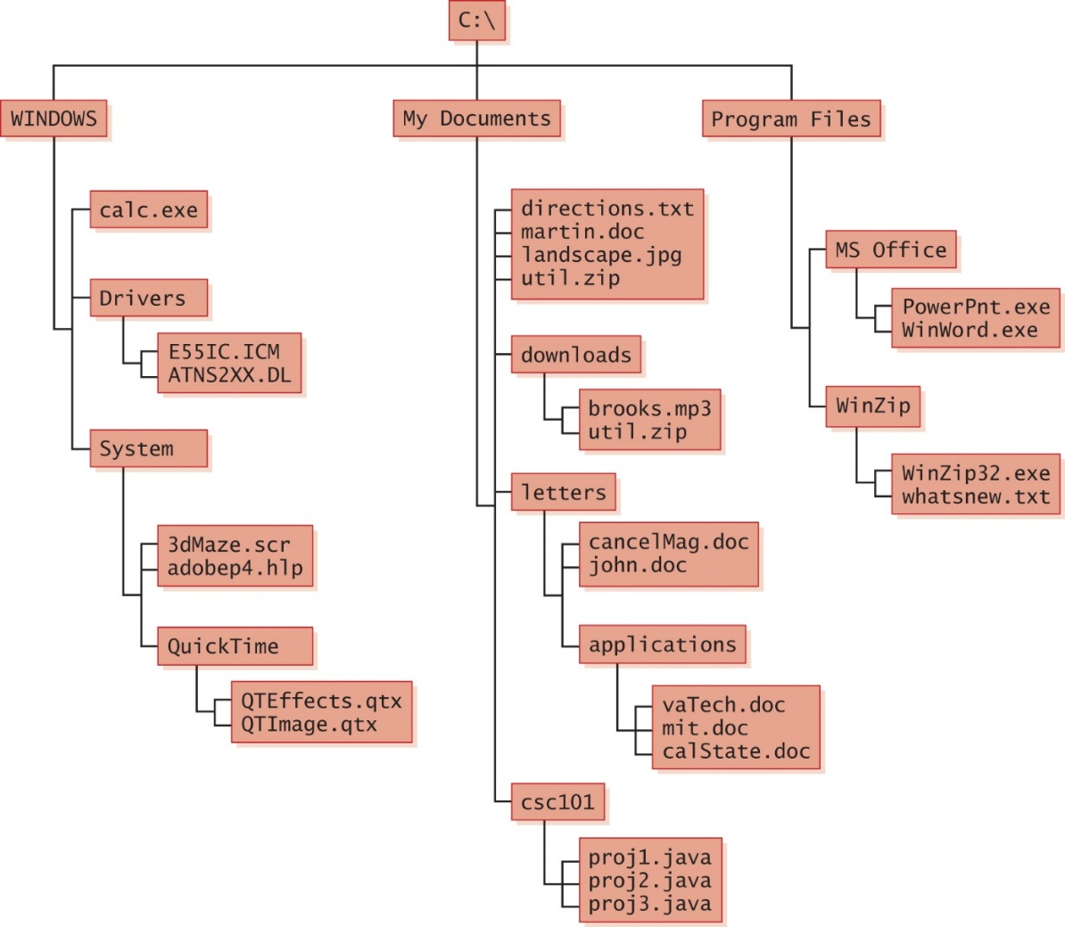
Directory Trees (3 of 4)
A Windows directory tree

Slide 19
Directory Trees (4 of 4)
At any point in time, you can be thought of as working in a particular location (that is, a particular subdirectory)
Working Directory
The subdirectory in which you are working

Slide 20
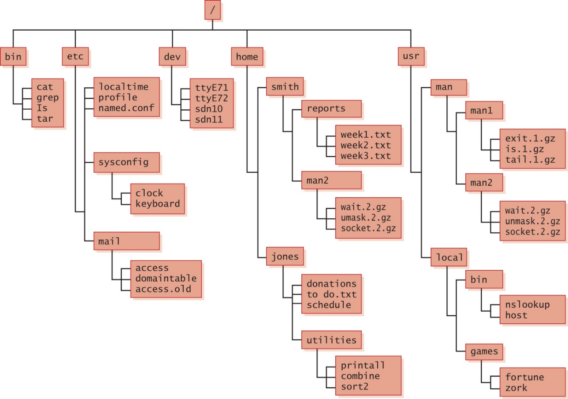
A Unix Directory Tree
A UNIX directory tree

Slide 21
Path Names (1 of 2)
Path
A text designation of the location of a file or subdirectory in a file system
Absolute Path
A path that begins at the root and includes all successive subdirectories
Relative Path
A path name that begins at the current working directory

Slide 22
Path Names (2 of 2)
Absolute Paths
C:\Program Files\MS Office\WinWord.exe
C:\My Documents\letters\applications\vaTech.doc
C:\Windows\System\QuickTime
If current working directory is:
C:\My Documents\letters
Relative Paths
cancelMag.doc
applications\calState.doc

Slide 23
Disk Scheduling (1 of 6)
As a computer deals with multiple processes over a period of time, a list of requests to access the disk builds up
Disk Scheduling
The technique that the operating system uses to determine which requests to satisfy first

Slide 24
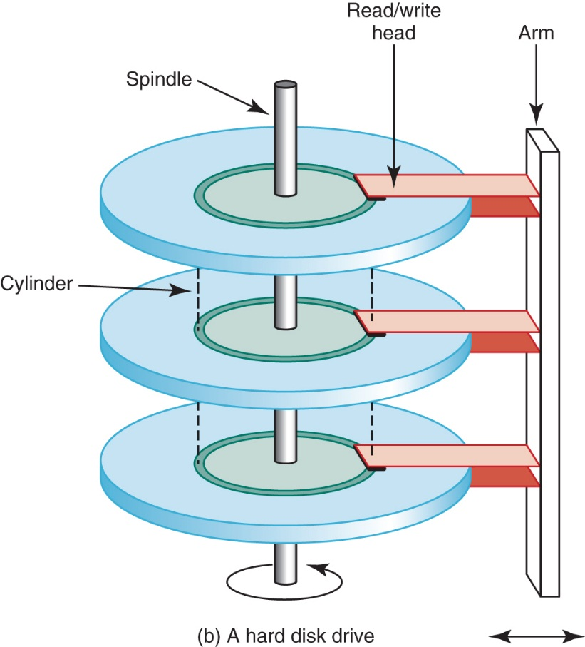
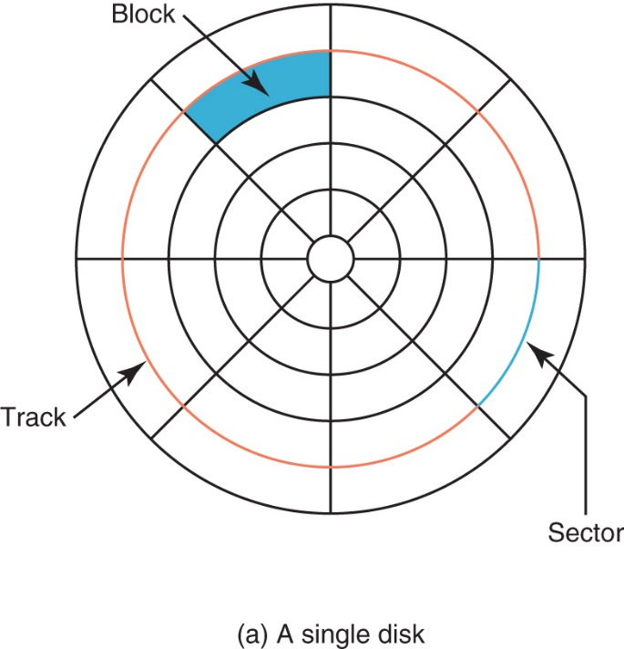
Disk Scheduling (2 of 6)
A magnetic disk drive
Remember seek time and latency?

Slide 25
Disk Scheduling (3 of 6)
First-Come, First-Served (FCFS)
Requests are serviced in the order they arrive, without regard to the current position of the heads
Shortest-Seek-Time-First (SSTF)
Disk heads are moved the minimum amount possible to satisfy a pending request
Scan
Disk heads continuously move in and out servicing requests as they are encountered

Slide 26
Disk Scheduling (4 of 6)
Ordered cylinder requests: 49, 91, 22, 61, 7, 62, 33, 35
Read/write heads at cylinder 26
In what order are they serviced if no more
requests arrive?
FCFS:
SSTF:

Slide 27
Disk Scheduling (5 of 6)
SCAN disk scheduling works like an elevator:
An elevator is designed to visit floors that have people waiting. In general, an elevator moves from one extreme to the other (say, the top of the building to the bottom), servicing requests as appropriate.
The SCAN disk-scheduling algorithm works in a similar way, except instead of moving up and down, the read/write heads move in toward the spindle, then out toward the platter edge, then back toward the spindle, and so forth

Slide 28
Disk Scheduling (6 of 6)
Ordered cylinder requests: 49, 91, 22, 61, 7, 62, 33, 35
Read/write heads at cylinder 26 moving toward cylinder 1
In what order are they serviced if no more
requests arrive?
SCAN

Slide 29
Ethical Issues
Spam
How many spam messages have you received today?
Why is spam expensive?
Have you ever sent spam?
Can you explain the CAN-SPAM Act?

Slide 30
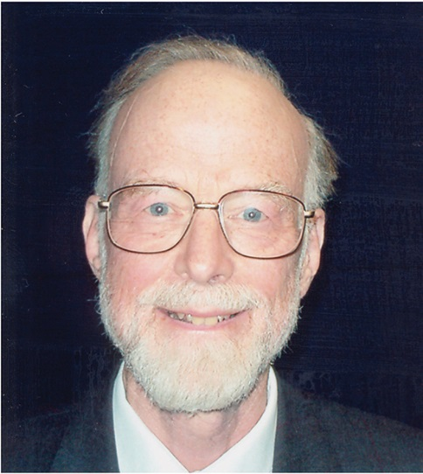
Who Am I?
I was awarded
Knighthood in
1999.
What university
did I retire from?
Courtesy of Inamori foundation
30
Notes:
30

Slide 31
Do You Know?
What is an RFID tag? What is it used for?
Why did people voluntarily let a club owner implant them with RFIDs?
What is HRV? How can software be used to monitor and reduce stress?
What is the eNeighbor System?
How can it be used to monitor conditions of the elderly?

